Slide 1
Guts Over Fear: The journey so far
Look where you are now
Week 11

Slide 2
Keynote: The Capeless Hero
CYBER
The main objective of security is to protect organisations and people.
This line of work allows you to support and interact with people across the globe.
This program was designed to give you the knowledge and skills you need to start and progress in the security profession.
CYBER
FUTURISTIC
SECURITY

Slide 3
week 01
Intro to Cyber Security

Slide 4
—Oracle
Cybersecurity is the practice of ensuring confidentiality, integrity, and availability of information by protecting networks, devices, people, and data from unauthorized access or criminal exploitation.

Slide 5
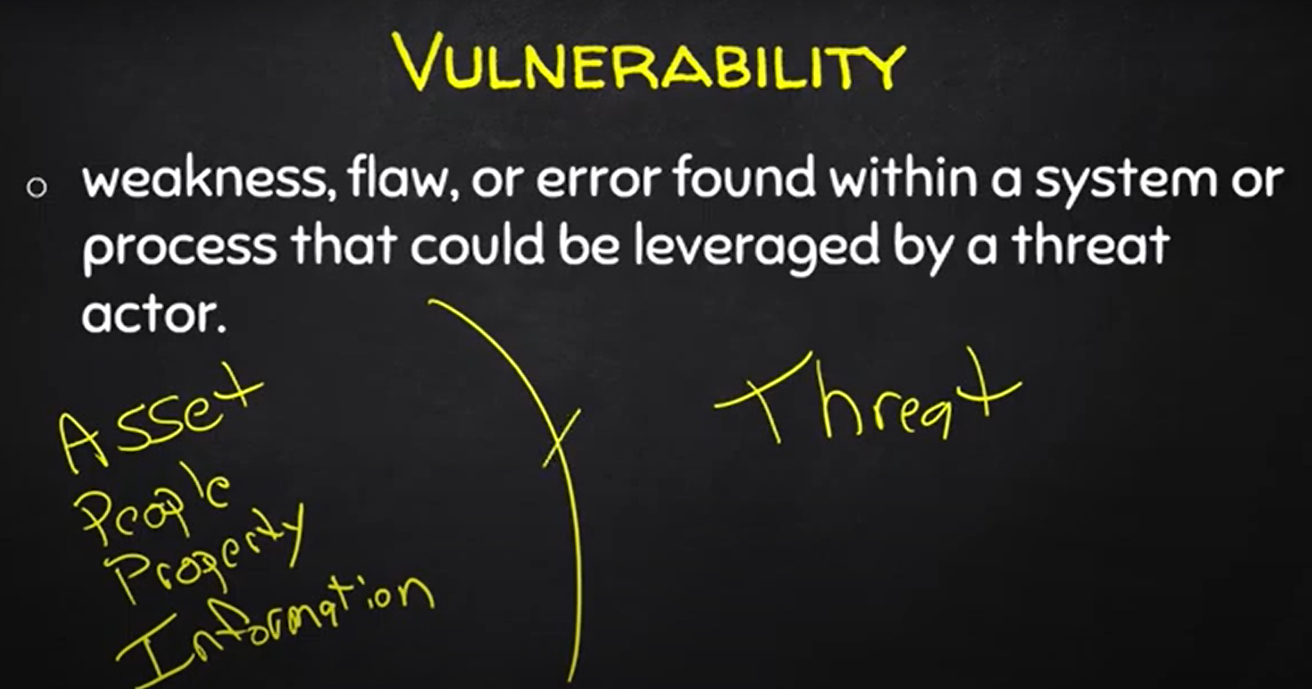
Purpose statement

Slide 6
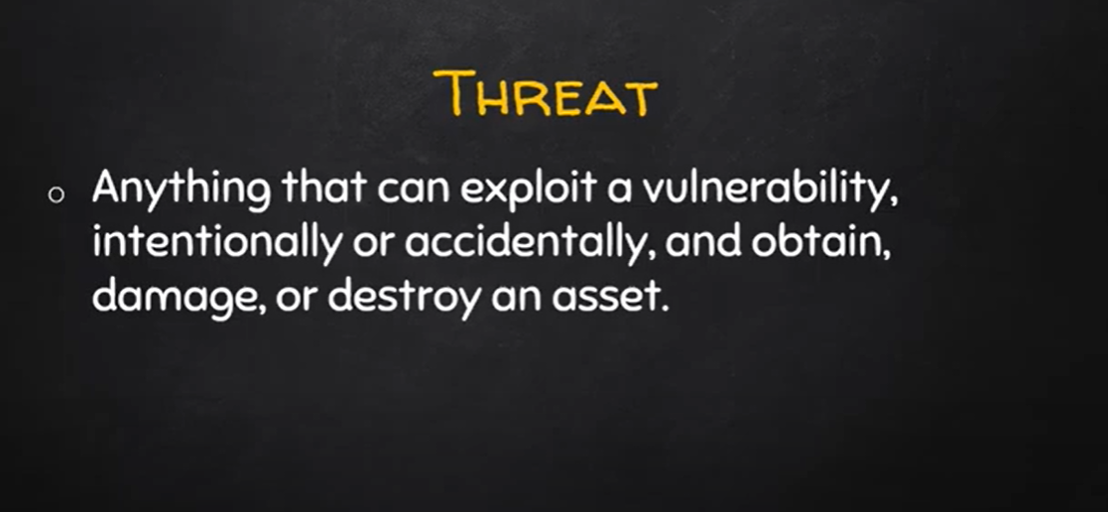
Purpose statement

Slide 7
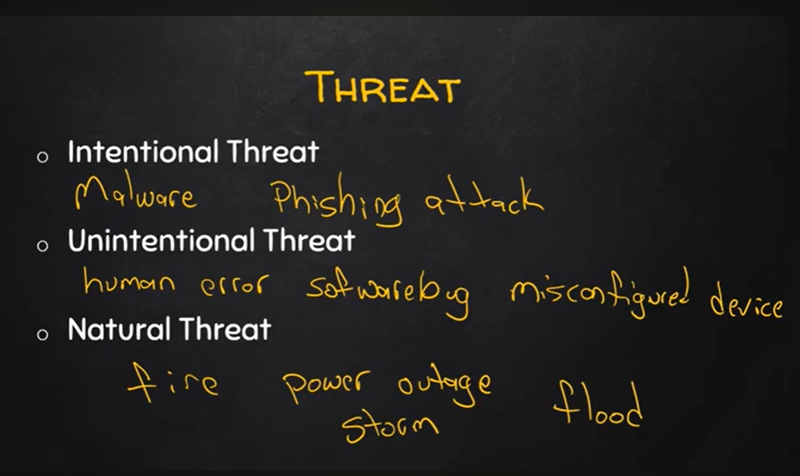
Purpose statement

Slide 8
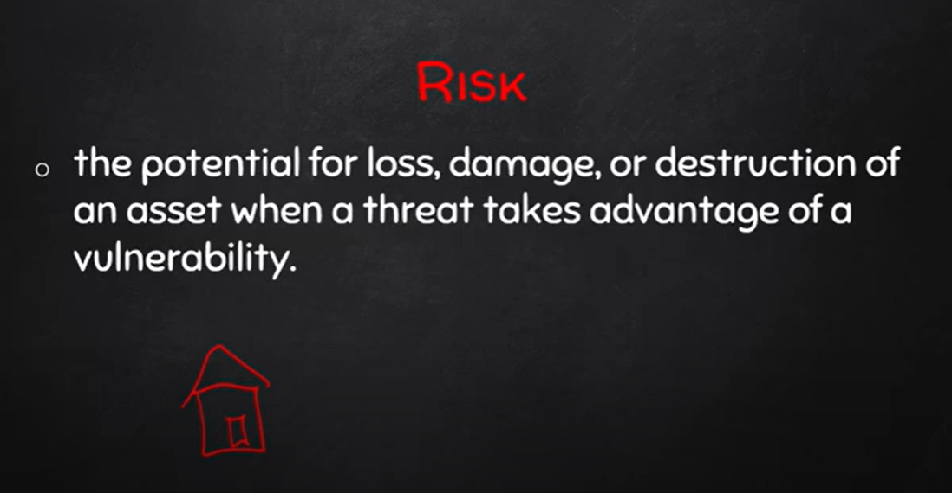
Purpose statement

Slide 9
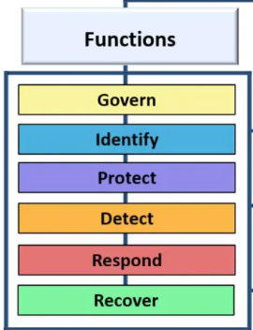
NIST Cybersecurity Framework
National Institute of Standards and Technology (NIST)

Slide 10
NIST Cybersecurity Framework
Govern: Define, communicate and monitor strategies, roles, risks and policies of the org.
Identify: Identify assets(data, hardware, identities, software) and perform cybersecurity risk assessments on the attack surface.
Protect: Ensure the core values of the CIA triad are implemented to manage security risks.
Detect: Monitor and analyze anomalies and other potentially adverse events that may indicate occurring attacks using Security Incidents and Events Management (SIEM) tools.
Respond: Utilize tools like dynamic playbooks to contain the effects of cybersecurity incidents. This process involves incident management, analysis, mitigation, reporting, and communication.
Recover: Timely restoration of assets and operations affected by a cybersecurity incident.

Slide 11
week 02
Security Domains

Slide 12
As of 2022, CISSP defined eight domains to organize the work of security professionals.

Slide 13
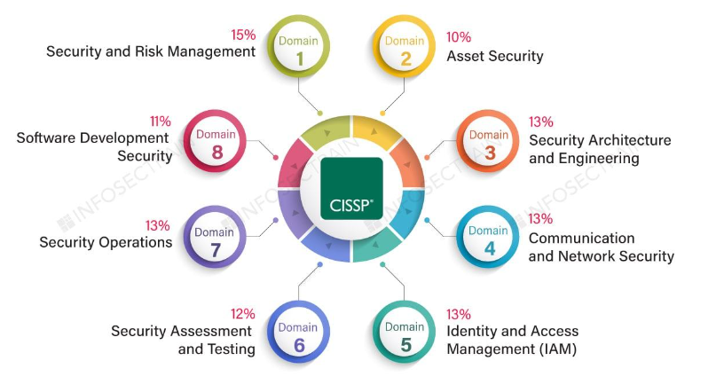
Certified Information Systems Security Professionals (CISSP) Security Domains.

Slide 14
Importance of Security Domains
The domains outline and organize how a team of security professionals work together.
Depending on the organization, your role may sit at the intersection of multiple domains or focus on one specific domain.
It's also important to understand the domains because it may help you better understand your career goals and your role within an organization.

Slide 15
Frameworks, Controls and Compliance
Security frameworks are guidelines used for building plans to help mitigate risks and threats to data and privacy. They have four core components:
Identifying and documenting security goals
Setting guidelines to achieve security goals
Implementing strong security processes
Monitoring and communicating results
E.g. National Institute of Standards and Technology (NIST)
Security controls are safeguards designed to reduce specific security risks. They are used alongside frameworks to ensure that security goals and processes are implemented correctly and that organizations meet regulatory compliance requirements.
Compliance is the process of adhering to internal standards and external regulations.

Slide 16
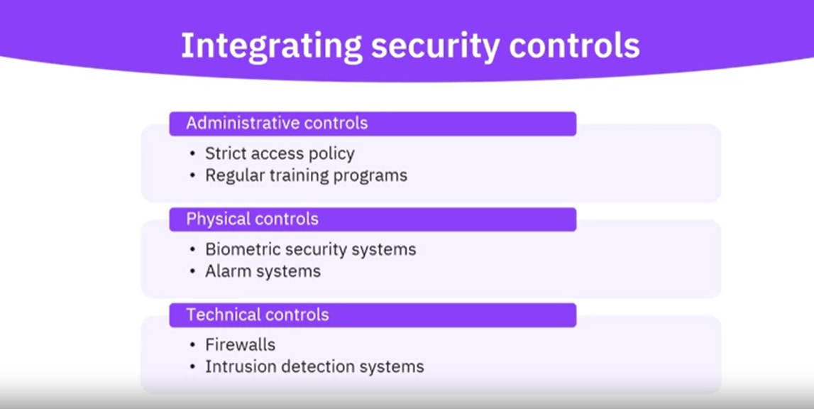
Security Controls

Slide 17
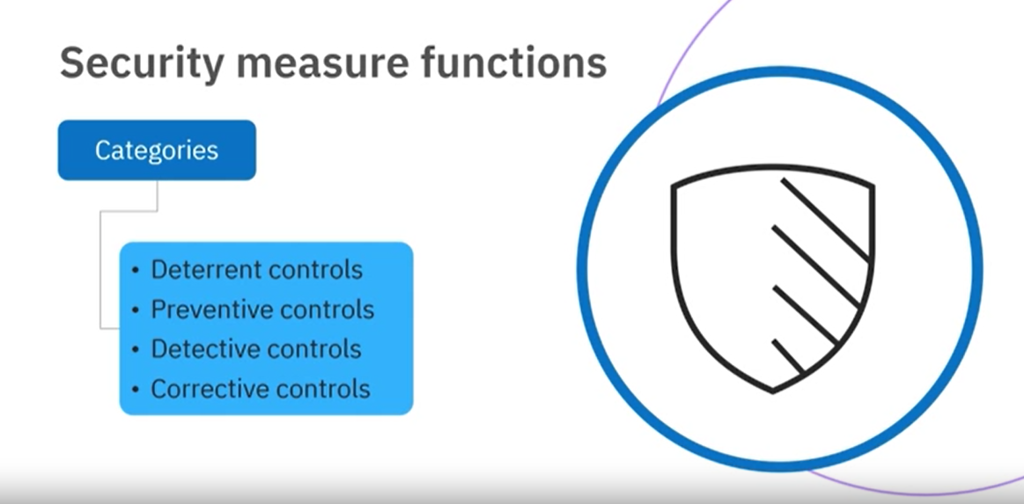
Categorizing Security Controls

Slide 18
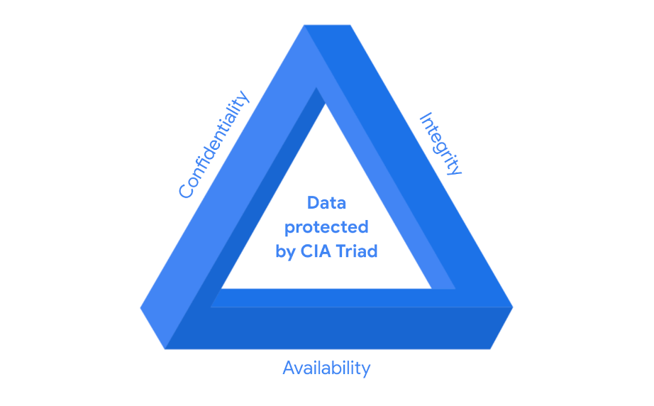
Purpose statement

Slide 19
Essential Tools and programming languages
week 03

Slide 20
https://www.hackthebox.com/blog/best-programming-languages-for-cybersecurity#mcetoc_1h7fbh19911k

Slide 21
Python
Programming involves a lot of design decisions
In Python, it's good practice to start with a comment.
A comment is a note programmers make about the intention behind their code.

Slide 22
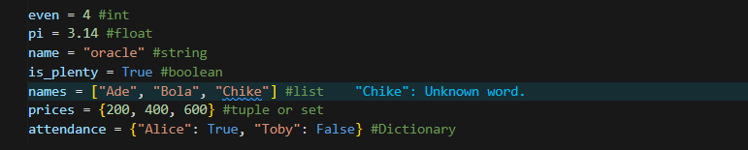
Python
A data type is a category for a particular type of data item

Slide 23
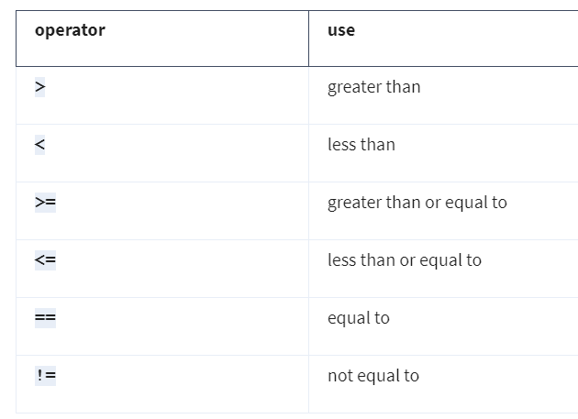
Conditionals
A conditional statement is that which checks code to determine whether it meets a specific set of conditions.
When a condition is met, it evaluates to a Boolean value of True.
When the condition isn’t met, it evaluates a Boolean value of False.

Slide 24
Conditionals
The keyword if starts a conditional statement
The keyword else is used only when all conditions preceding it within the conditional statement are evaluated as False.
The elif keyword precedes a condition that is only evaluated when previous conditions evaluate as False.

Slide 25
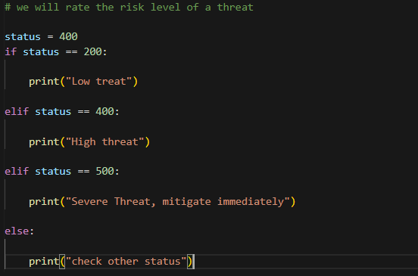
Conditionals

Slide 26
Iterations
An iterative statement is code that repeatedly executes a set of instructions.
Depending on the criteria, iterative statements execute zero or more times.
We iterated through code using both for loops and while loops.

Slide 27
For Loop Interation
If you need to iterate through a specified sequence, you should use a for loop.

Slide 28
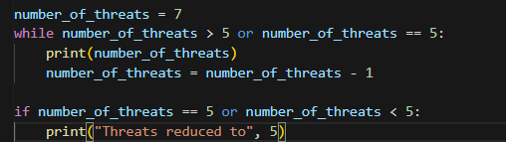
While Loop Interation
If you want a loop to iterate based on a condition, you should use a while loop.

Slide 29
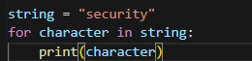
Fun fact!!!
Strings are also lists and can be iterated through.

Slide 30
Functions
A function is a section of code that can be reused in a program.
Functions are important in Python because they allow you to automate repetitive parts of your code. In cybersecurity, you will likely adopt some processes that you will often repeat.
When working with security logs, you will often encounter tasks that need to be repeated.
For example, if you were responsible for finding malicious login activity based on failed login attempts, you might have to repeat the process for multiple logs.
To work around that, you could define a function that takes a log as its input and returns all potentially malicious logins.
It would be easy to apply this function to different logs.

Slide 31
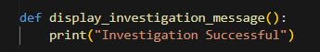
Functions
The def keyword is placed before a function name to define a function.
Tip: When naming a function, give it a name that indicates what it does.

Slide 32
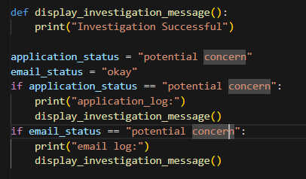
Calling a function
Using a function after defining it is referred to as calling a function.

Slide 33
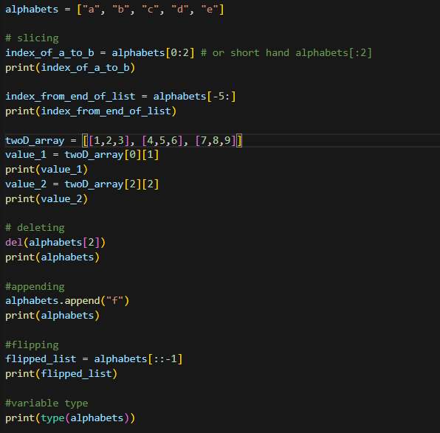
Working With Lists

Slide 34
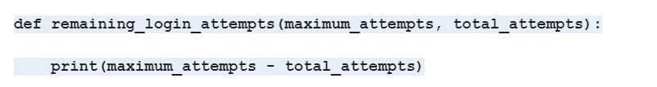
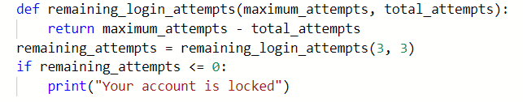
Working with variables in functions
Parameter: A parameter is an object that is included in a function definition for use in that function
Augments: In Python, an argument is the data brought into a function when it is called.
Return: The return keyword is used to return information from a function.

Slide 35
Understanding Networks and Network scanning
week 04

Slide 36
What is a Network
A network is a group of connected devices.
The devices on a network can communicate with each other over network cables or wireless connections.
Devices need to find each other on a network to establish communications.
These devices will use unique addresses, or identifiers, to locate each other. These are called the IP and MAC addresses.
Devices can communicate on two types of networks: a local area network, also known as a LAN, and a wide area network, also known as a WAN.

Slide 37
Network Security
Network security is important because we want to ensure that our network systems are safe and resilient to defend against malicious hackers and that we can protect our user data.
Working with network security allows us to see the overview of the whole company's network systems.
When working in network security, there are often going to be requests that come from network teams and security teams that have specific requirements on certain platforms or on a feature that they need in one of the network policies, which you may need to escalate or try to work on a fix for.

Slide 38
Network Security Applications
An entry-level cybersecurity analyst would look at using command lines, log parsing, and network traffic analysis in their everyday scope of work.
The command line allows you to interact with various levels of your operating system.
Logs in log parsing help and support you in finding out and debugging what is going on in your program or application.
Network traffic analysis is looking at networks across various application and network layers and seeing what that traffic is doing, how it can be secured as well as identify any vulnerabilities and concerns.

Slide 39
week 05
Network Scanning

Slide 40
What is Nmap
Nmap is a tool used to check computer networks and see what's there. It can find out which computers are connected and what programs they're running. It can even figure out what type of computer it's talking to.
Uses of Nmap
To check if a network is safe.
To test how secure a network is.
To see if firewalls and security systems are set up correctly.
Nmap has different ways to do its job:
It can find computers on the network.
It can check what ports are open on a computer.
It can figure out what services are running on those ports.
It can even guess what type of computer it's talking to.

Slide 41
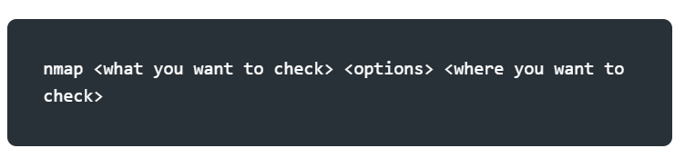
A Typical Nmap command

Slide 42
An Example
Lets perform a basic network scan on your local machine
On your terminal type ‘ifconfig’ or ‘ip addr’
Copy your ip address
Type nmap <machine_ip>
Another site we are authorized to scan is scanme.nmap.org
Type nmap scanme.nmap.org

Slide 43
Key terms in Networking
Ports: A port is like a door on your computer or device that allows different kinds of internet traffic to come in and go out. Different doors (ports) are used for different things, like browsing the web or sending emails.
Host: A host is any device, like your computer or phone, that is connected to a network (like the internet) and can send or receive information.
Service: A service is a specific job or function that a computer or server performs over a network, like hosting a website, handling emails, or running an online game.
Flags: Flags are signals used in network communication to control or manage how data is sent and received between devices. Think of them as markers that indicate what should happen next.

Slide 44
Key terms in Nmap
Subnet Mask: A subnet mask helps divide an IP address into two parts: the part that tells which network a device is on and the part that tells which specific device it is. It’s like dividing an address into the street name (network) and house number (device).
Switch: A switch is a device that helps connect multiple computers or devices in the same building (local network). It directs data only to the device that needs it, making everything work faster.
Router: A router connects different networks, like your home network and the internet, and makes sure data gets to the right place.

Slide 45
Network segment
A network segment is a group of computers connected using a shared medium.
This medium can be the Ethernet switch or WiFi access point.
In an IP network, a subnetwork is usually the equivalent of one or more network segments connected and configured to use the same router.
The network segment refers to a physical connection, while a subnetwork refers to a logical connection.

Slide 46
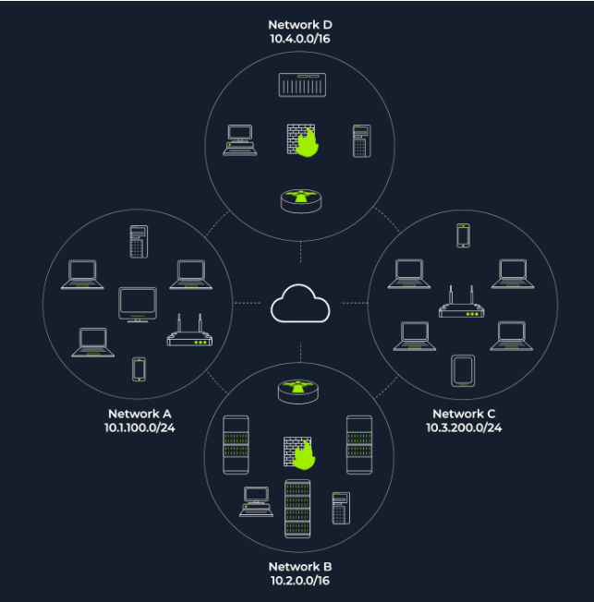
Network segment
In this network diagram, we have four network segments or subnetworks.
A subnetwork, or simply a subnet, has its IP address range and is connected to a more extensive network via a router.
N/B: a firewall might enforce security policies depending on each network.

Slide 47
Network segment
Nmap relies on different approaches to discover live hosts, including:
ARP scan: This uses ARP requests. An Address Resolution Protocol is responsible for finding the MAC (hardware) address related to a specific IP address. It works by broadcasting an ARP query, and receiving the response to discover live hosts.
TCP/UDP ping scan: This scan sends packets to TCP ports and UDP ports to determine live hosts.

Slide 48
Enumeration
Enumeration is the process of gathering information about a system, such as usernames, machine names, network resources, shares, and services
Enumeration is the process of gathering information about a system, such as usernames, machine names, network resources, shares, and services
To a security analyst, this step is critical in the reconnaissance phase of ethical hacking or penetration testing where you aim to find out some of the weaknesses/vulnerabilities within the target.

Slide 49
Nmap Enumeration
We need to specify the targets we want to scan. This can be done by providing a list, a range, or a subnet.
Examples of target specifications are:
list: MACHINE_IP scanme.nmap.org example.com will scan 3 IP addresses.
range: 10.11.12.15-20 will scan 6 IP addresses: 10.11.12.15, 10.11.12.16,… and 10.11.12.20.
subnet: MACHINE_IP/30 will scan 4 IP addresses.
N/B: We will focus on using subnets for this lecture.

Slide 50
Fingerprinting
OS fingerprinting is a technique used to determine the type and version of the operating system running on a remote host.
Here we’ll be checking the operating system and the system version being used on the available hosts.
Run the command:
sudo nmap –O –sV <machine_ip>/24
N/B fingerprinting requires administrative permission, hence, the sudo flag
The –O represents operating system and the –sV represents system version.

Slide 51
Vulnerability scanning
Nmap includes a powerful scripting engine (NSE) that allows you to scan for specific vulnerabilities. Use the following command to run common vulnerability checks:
nmap --script vuln <machine_ip>/24
N/B: This data can be save to a file by adding the flag –oN <name_of_file.txt>

Slide 52
Network Intrusion and Security Controls.
week 06

Slide 53







Network Intrusion
Network Intrusions refer to unauthorized attempts to access network resources, data, or services. These can be launched by malicious actors to steal sensitive data, disrupt operations, or compromise systems.
The objective of studying it prevent or minimize unauthorized access and protect the system from intrusions.

Slide 54



Role of UFW in Network Security

Slide 55
What is UFW?
UFW (Uncomplicated Firewall) is a user-friendly front-end for managing iptables firewall rules in Linux systems.
It simplifies configuring firewall rules to control incoming and outgoing traffic

Slide 56

Summary of UFW
Access Control: Restricts access to services based on IPs and ports.
Port Filtering: Reduces exposure by blocking unnecessary services.
ICMP Management: Prevents ping floods and network scans.
Default Deny Policy: Blocks all incoming traffic unless explicitly allowed, ensuring only authorized access.
Ease of Use: UFW simplifies the management of security policies without compromising on robustness.
By implementing UFW, organizations can effectively harden their network perimeter,
protecting it from intrusions and unauthorized access while maintaining control over
legitimate traffic.

Slide 57
Network Analysis
Network analysis is the process of capturing, inspecting, and analysing data packets moving across a network.
This process is useful in:
monitoring performance.
Identifying network vulnerabilities.
Detecting security breaches and intrusions.

Slide 58
Role of Wireshark in Network Analysis

Slide 59
What is Wireshark
Wireshark is a free, open-source packet sniffer and analysis tool used to capture and inspect real-time network traffic.
This tool is useful in:
Providing a detailed view of all incoming and outgoing traffic on a network interface.
Allowing filtering of traffic by protocol, IP address, ports, and other criteria.
network troubleshooting, security audits, and forensics.

Slide 60
Wireshark for intrusion detection
Why Use Wireshark for Intrusion Detection?
Security analysts can detect anomalous patterns in network traffic that indicate malicious activities.Identifies attacks such as SYN floods, brute force login attempts, and data exfiltration.

Slide 61
Incident Response Playbooks
week 07

Slide 62



Introduction
What is an Incident Response Playbook?
A structured guide for responding to cybersecurity incidents.
Standardizes processes, making response efficient and effective.
Why are Playbooks Important?
Ensures consistency.
Reduces response time.
Minimizes damage and downtime.

Slide 63
Types of security Incidents
Data breaches
Malware/Ransomware attacks
Phishing/Social Engineering attacks
Insider threats
Denial of Service (DoS) attacks
Misconfigurations/Vulnerabilities exploitation

Slide 64
Structure of a Playbook
1. Preparation
Risk assessment, security tools, and communication plans.
2. Identification
Detecting and confirming an incident.
3. Containment
Isolating affected systems to prevent spread.
4. Eradication
Removing the threat from the environment.
5. Recovery
Restoring normal operations.
6. Lessons Learned
Conducting post-incident reviews and improving processes.

Slide 65
Key Elements of a Playbook
Roles and responsibilities
Communication plan (internal/external)
Detailed steps for different scenarios
Documentation and reporting templates
Escalation process
Reference to relevant regulations/compliance (e.g., GDPR, HIPAA)

Slide 66
Developing a Network Security Model
week 08

Slide 67
What is a Network Security Model?
The purpose of computer network security (CNS) is to transform plain text data into encrypted ciphertext before sending it over the vulnerable network channel so that potential attackers cannot decipher or make sense of the information.

Slide 68
Network Security Model
This is achieved by applying a cryptographic algorithm powered by a secret key known only to the communicating parties in the network security model in CNS.

Slide 69
Building Blocks of a Network Security Model
Algorithm Design: An encryption algorithm encodes plaintext into ciphertext and decodes cypher text back into plain text. The algorithm’s strength relies on its ability to withstand cracking attempts by adversaries.
Secret Information Generation: Creation of cryptographic keys to protect data.
Key Distribution Methods: A trusted third party facilitates the secret key exchange in the network security model in CNS.
Protocols: Establish communication rules (e.g., TLS) to manage secure connections.

Slide 70
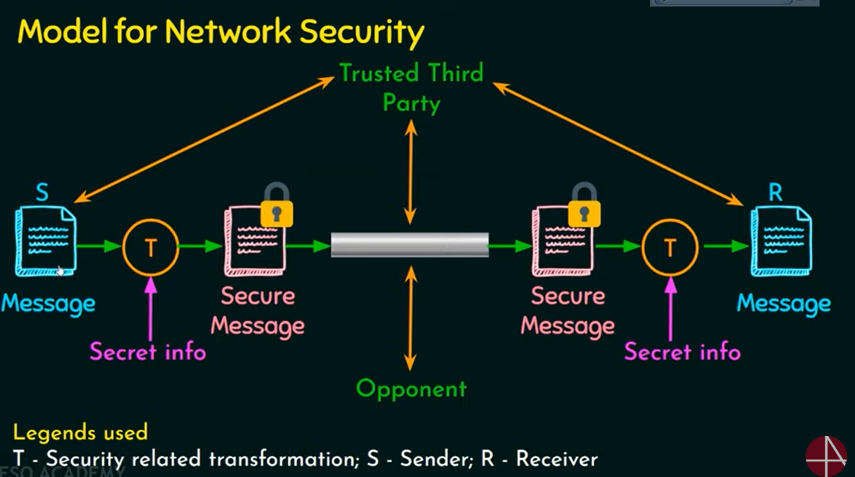
Network Security Model

Slide 71
What is Cryptography
Cryptography is the process of hiding or coding information so that only the person a message was intended for can read it.
Cryptography mainly uses mathematical principles and a series of formulas and algorithms to encrypt messages so that decrypting these messages becomes impossible

Slide 72
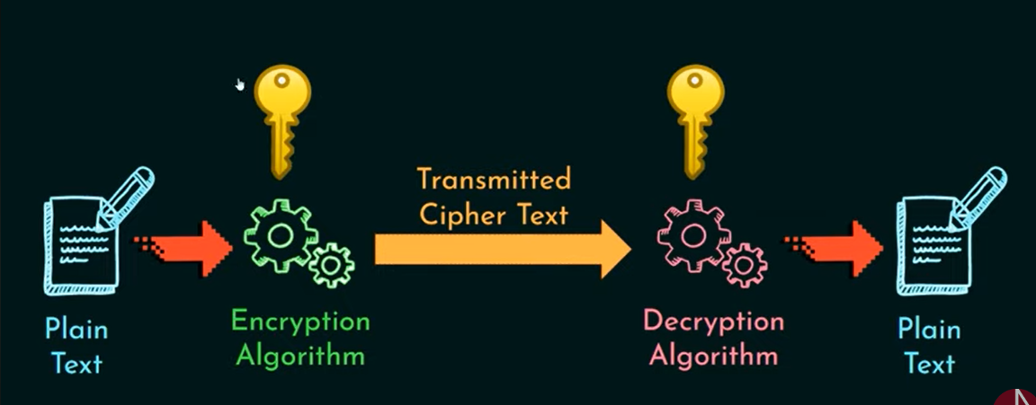
Workflow of Cryptography

Slide 73
Importance of Cryptography
Strong network security models extensively use cryptography and data encryption techniques to safeguard confidential data against cyber attacks.
Models of network security in Cryptography can help address threats like data tampering, impersonation and forgery by leveraging cryptographic authentication mechanisms involving security certificates, keys or signatures.
Modern network security models adopt a defence-in-depth approach with multilayered controls.

Slide 74
Terminology in Cryptography
Plain Text: A readable text which can be understood by all users. The plain text is the message which undergoes cryptography.
Cipher Text: The message obtained after applying cryptography on plain text.
Encryption: The process of converting plain text to cypher text. It is also called encoding.
Decryption: The process of converting cypher text to plain text. It is also termed decoding.

Slide 75
Types of Cryptography
Symmetric key cryptography: It mainly involves using a single key, called a secret key, used for encrypting and decrypting the data.
Asymmetric key cryptography : It involves using two different keys for encrypting and decrypting the data.

Slide 76
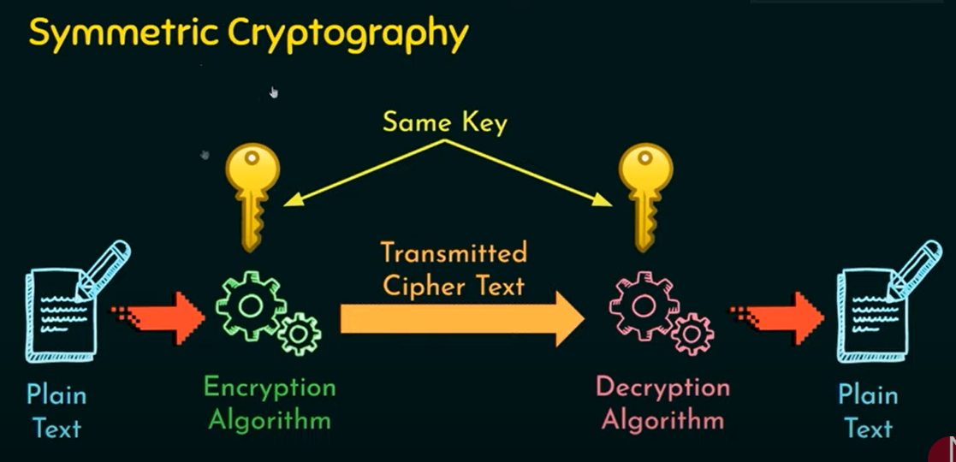
Workflow of Cryptography

Slide 77
Application Security and Vulnerability Testing
week 09

Slide 78
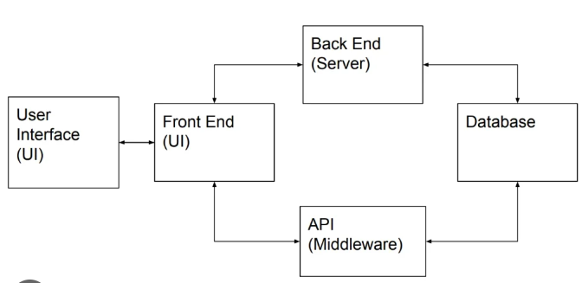
How do applications work?
Applications are collections of code that allow users to perform specific tasks, interact with data, and connect with other systems.

Slide 79
Components
Frontend (Client-side): The interface users interact with.
Backend (Server-side): Processes requests, manages data, and communicates with databases.
Database: Stores and manages application data.

Slide 80
What is application security?
Application security is the process of developing, adding, and testing security features within applications to prevent security vulnerabilities against threats such as unauthorized access and modification.
Application security ensures applications resist attacks to protect sensitive data and maintain reliability.

Slide 81
Application security features
Different types of application security features include authentication, authorization, encryption, logging, and application security testing. Developers can also code applications to reduce security vulnerabilities.

Slide 82
Authentication
When software developers build procedures into an application to ensure that only authorized users gain access to it. Authentication procedures ensure that a user is who they say they are. This can be accomplished by requiring the user to provide a user name and password when logging in to an application

Slide 83
Authorization
After a user has been authenticated, the user may be authorized to access and use the application

Slide 84
Encryption
After a user has been authenticated and is using the application, other security measures can protect sensitive data from being seen or even used by a cybercriminal.

Slide 85
Logging
If there is a security breach in an application, logging can help identify who got access to the data and how. Application log files provide a time-stamped record of which aspects of the application were accessed and by whom.

Slide 86
Application security testing
A necessary process to ensure that all of these security controls work properly

Slide 87
What is application security testing?
Application testing refers to testing any software application using scripts, tools, or test automation frameworks to identify errors. It helps teams release bug-free and robust software applications into the real world.

Slide 88

Methodologies for Application testing.

Slide 89
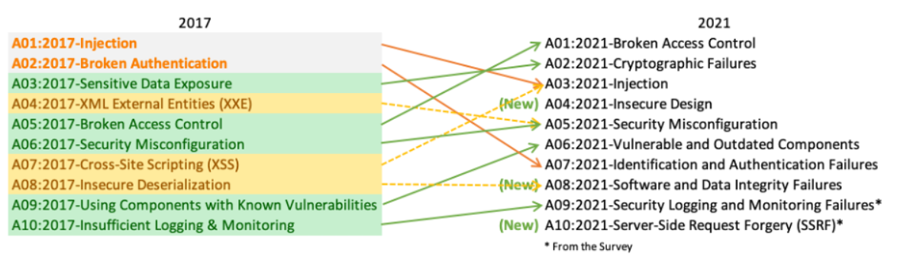
OWASP Top 10
OWASP (Open Web Application Security Project) provides a comprehensive set of resources and methodologies designed to improve software security.

Slide 90
Application Security Testing Phases

Slide 91
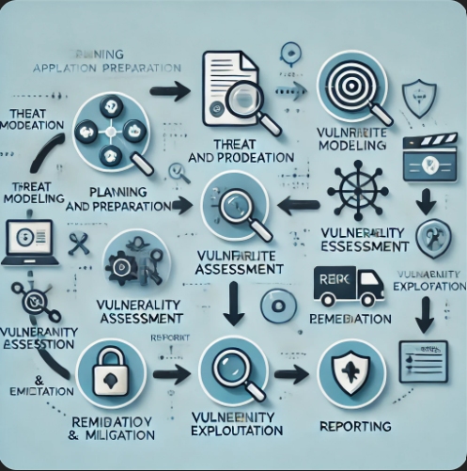
Phases/Steps
Planning and Preparation: Define objectives and create a test plan.
Threat Modeling: Identifying threats based on the app’s architecture.
Vulnerability Assessment: Automated tools to detect vulnerabilities.
Vulnerability Exploitation: Testing real-world exploitability.
Remediation and Mitigation: Fix vulnerabilities.
Reporting: Clear, actionable reports for security teams.

Slide 92
Burp suite

Slide 93
What is Burp suite
Burp Suite is a comprehensive platform for performing security testing of web applications. It is widely used by penetration testers and security researchers for its robust features and flexibility.

Slide 94
Key features of Burp suite
Define Scope: Ensure only the test target is defined in Burp.
Proxy Use: Capture and inspect HTTP requests/responses.
Scanner: Automated scans to detect vulnerabilities.
Repeater: Manually edit and resend requests to simulate attacks.
Intruder: Automated input for testing fuzzing or injection vulnerabilities

Slide 95
Open-Source Intelligence (OSINT)
week 10

Slide 96
What is OSINT?
Open-Source Intelligence (OSINT) is gathering information from publicly available sources for security purposes.
Relevance in Cybersecurity: Critical for threat intelligence, vulnerability assessments, penetration testing, and incident response.

Slide 97
Intelligence Cycle
For these situations, there has always been a process of knowledge creation called The Intelligence Cycle.
This iterative model describes a series of stages and procedures that a researcher has to perform to convert the collected data and information into intelligence products capable of bringing solutions to the organization.

Slide 98
Planning and Direction
This is where you determine the purpose of your research and what kind of information you are looking for.

Slide 99
Collection
In this second phase, your objective will be identifying which processes you will use to collect such information, and then, using all the techniques you know, obtain the data that will help you carry out your intelligence operation.

Slide 100
Processing of data and information
Here your objective is not only the visualization of the information but also the application of decoding, decryption, validation, and evaluation techniques that will allow you to filter the huge amount of information you obtained, to identify useful data for your research.

Slide 101
Analysis to produce meaningful intelligence
Here you must compile all the information you filtered in the previous step to obtain the solutions to your initial problem, as well as create a coherent intelligence product (report, conference, etc.) that allows you to explain the process you recently carried out clearly

Slide 102
Dissemination of intelligence to the clients
The final step. Here you must deliver the product you developed throughout the process to the stakeholders (individuals or groups) that requested it. This will help these people make informed and appropriate decisions when tackling the original problem.

Slide 103
OSINT Tools
Maltego: A powerful tool that can aggregate and visualize data from social media, emails, websites, and other online platforms. Useful for mapping relationships and networks.
theHarvester: Collects emails, subdomains, and other information from a domain. Supports multiple sources like Bing, Google, and LinkedIn.
TruthFinder: Searches public records for background information, including addresses, social profiles, and criminal records.
OSINT Framework

Slide 104
The Way Forward: Specialization and Certifications

Slide 105
Specialization and Certifications
1. General Cybersecurity Fundamentals:
CompTIA Security+
Overview: Covers general cybersecurity concepts, including network security, threats, vulnerabilities, and risk management.
Ideal For: Beginners looking for a broad foundation in cybersecurity.
ISC² Certified in Cybersecurity (CC)
Overview: Focuses on security principles, controls, and concepts essential for all cybersecurity roles.
Ideal For: Those new to cybersecurity and considering the CISSP later.
2. Network Security:
CompTIA Network+
Overview: Provides foundational knowledge on networking concepts, protocols, and troubleshooting – important for understanding network-based attacks and defenses.
Ideal For: Beginners interested in networking aspects of cybersecurity.
Cisco Certified CyberOps Associate
Overview: Focuses on network security fundamentals, security monitoring, and incident response.
Ideal For: Those interested in security operations and network monitoring.

Slide 106
3. Application Security:
Certified Application Security Engineer (CASE) by EC-Council
Overview: Teaches the principles of secure software development and secure coding practices.
Ideal For: Beginners interested in application security and software development.
Secure Coding Practices (Offered by Various Platforms like Cybrary and OWASP)
Overview: Courses on secure coding practices based on OWASP and other frameworks.
Ideal For: New developers and those who want to understand software security basics.
4. Ethical Hacking and Penetration Testing
EC-Council Certified Ethical Hacker (CEH)
Overview: Introduces penetration testing basics, tools, and techniques.
Ideal For: Those interested in ethical hacking.
CompTIA Pentest+
Overview: More hands-on and practical than CEH, focusing on the skills needed to perform penetration testing.
Ideal For: Beginners who want a technical understanding of penetration testing.

Slide 107
5. Cloud Security
CCSP (Certified Cloud Security Professional) by (ISC)² – Associate Level
Overview: Covers fundamental cloud security principles and risk management.
Ideal For: Those interested in cloud security, especially on AWS, Azure, or GCP.
Microsoft Certified: Security, Compliance, and Identity Fundamentals
Overview: Basic cloud security fundamentals focused on the Microsoft Azure platform.
Ideal For: Beginners interested in Microsoft cloud environments.
6. Digital Forensics and Incident Response (DFIR)
Certified Incident Handler (ECIH) by EC-Council
Overview: Covers the basics of incident handling and response.
Ideal For: Those interested in managing and responding to cybersecurity incidents.
Certified Cyber Incident Responder (CCIR)
Overview: Provides knowledge on responding to incidents, investigating breaches, and handling digital forensics.
Ideal For: Beginners exploring the field of incident response and forensics.

Slide 108
7. Governance, Risk, and Compliance (GRC)
Certified in Cybersecurity (CC) by (ISC)²
Overview: Introduces cybersecurity principles, governance, risk, and compliance.
Ideal For: Beginners interested in compliance and risk management roles.
ISACA Cybersecurity Fundamentals
Overview: Covers general cybersecurity, risk management, and security policy basics.
Ideal For: Those interested in GRC roles or a general understanding of cybersecurity.
8. Open Source Intelligence (OSINT)
Certified OSINT Professional (OSINT Academy)
Overview: Covers OSINT techniques and tools for gathering intelligence.
Ideal For: Those interested in intelligence gathering, reconnaissance, or social engineering.
SANS SEC487: Open-Source Intelligence (OSINT) Gathering and Analysis
Overview: Teaches OSINT collection and analysis techniques.
Ideal For: Beginners interested in OSINT and digital investigations.

Slide 109
Preview of Capstone Project
Network Analysis Task
Cryptography Task
Programming Task
Osint Task
Playbook Task

Slide 110
Not All Heroes Wear Capes Some wear Hoodies

Slide 111
Thanks!
Do you have any questions?
amosmarvellous48@gmail.com
+234 702 625 4613

